Slide 1

Learning to learn with Meta-Learning
Shree Gowri Radhakrishna

Slide 2
References
This presentation is based on the paper “A COMPREHENSIVE OVERVIEW AND SURVEY OF RECENT
ADVANCES IN META-LEARNING”, authored by Huimin Peng.
[1] H. Peng. A comprehensive overview and survey of recent advances in meta-learning (2020). arXiv:2004.11149 [cs.LG].
[2] T. Hospedales, A. Antoniou, P. Micaelli, A. Storkey. Meta-Learning in Neural Networks: A Survey (2020). arXiv:2004.05439 [cs.LG].

Slide 3
What is Meta-Learning?
Learning to learn
Learn weight initialization
Learn metric space
Learn optimizers
Rapid, accurate model adaptation to unseen tasks
Applications in automated AI, zero shot learning, NLP, robotics
Similarity measure between related tasks

Slide 4
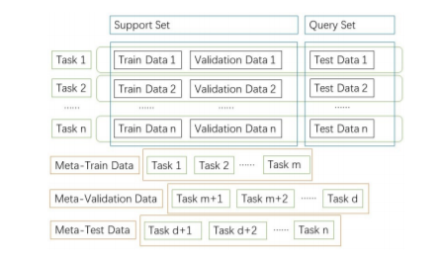
Architecture
Figure 1: Upper part of the figure shows: training data, validation data, and testing data. The lower part of the figure shows meta-training data, meta-validation-data, and meta-testing data with tasks. (H. Peng, 2020)

Slide 5
Why Meta-Learn?
Self-improvement, automated AI
Adaptation to unseen tasks, different than trained tasks

Slide 6
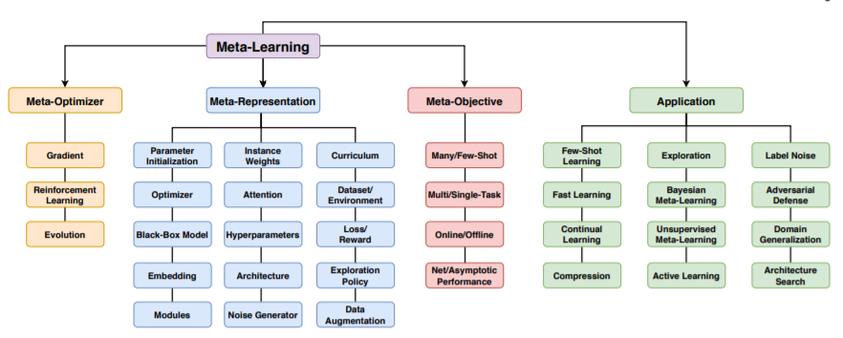
Meta Learning paradigm
Figure 2: Overview of meta-learning paradigm (T. Hospedales et al., 2020)

Slide 7
Methodologies
Black box Meta Learning
Based on neural networks
AdaResNet and AdaCNN
Metric-based Meta Learning
Based on a similarity measure
SNAIL, Relation Network, Prototypical Network, Dynamic few-shot, Mean Average Precision.
Layered Meta Learning
Base Learner + Meta Learner
MAML, Meta-LSTM, R2-D2 and LR-D2, TPN and LEO.
Bayesian Meta Learning
AI-GAs, Neural Statistician, LLAMA, BMAML and VERSA.

Slide 8
Black box meta learning
Black box uses neural networks to improve generalization and to model policy and policy self-improvement
In the area of AutoML to accelerate the search for an optimal neural network model
For different hyper-parameter combinations, meta-learner can predict model performance based on previous training experiences.
AdaResNet and AdaCNN [

Slide 9

Black box meta learning
Figure 3: Black-box meta-learning. (H. Peng, 2020)

Slide 10
Metric based meta learnign
This includes:
SNAIL
Prototypical Networks
Relational Networks
Dynamic few-shot
Mean Average Precision

Slide 11
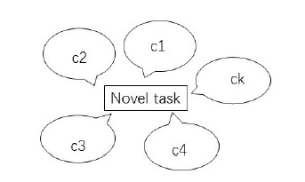
Metric based meta learnign
Figure 4: Metric-based meta-learning. ci is the centroid of class i. Distances between a novel task and centroids are compared. A new sample joins the closest class. (H. Peng, 2020)

Slide 12
Layered meta learning
This includes network:
MAML
Meta-LSTM
R2-D2 and LR-D2
TPN
LEO

Slide 13
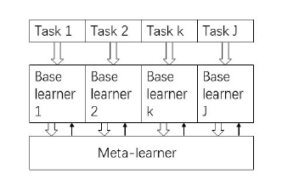
Layered meta learning
Figure 4: Learner and meta-learner framework of meta-learning. The base learner is trained on each task. Meta-learner updates task-specific components in base learner for adaptation across different tasks. (H. Peng, 2020)

Slide 14
Bayesian meta-learning
This includes:
AI-Gas
Neural Statistician
LLAMA
BMAML
VERSA

Slide 15
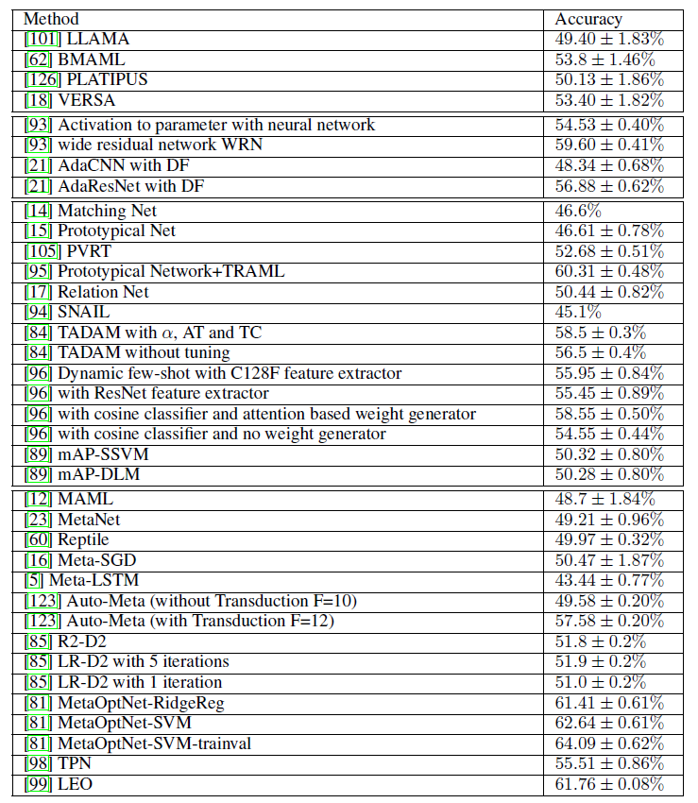
Comparison of accuracies of models from all meta learning paradigm (H. Peng, 2020)

Slide 16
Applications
Robotics
Automated trading
Learning rare languages
Drug discovery – high dimensional data + small sample size
Meta-reinforcement learning

Slide 17
Overall quality and critique
Well structured paper
Covers basic concepts of meta learning, framework, methodologies and applications
Gentle introduction to recent advances in the meta learning paradigm

Slide 18
Improvements and Future enhancements
More in-depth understanding of the different architectures
More comparison of benchmarks applied to different domains

Slide 19
Thank you!

